Slide 1
MULTIPLE DISEASE PREDICTION SYSTEM
.

Slide 2

INTRODUCTION
Machine Learning is the domain that uses past data for predicting. Machine Learning is the understanding of computer system under which the Machine Learning model learn from data and experience.
Now day’s heart diseases are growing rapidly by busy and stress full life. All type of age groups is under diseases so need of early detection of disease by using symptoms or reports
We are applying complete machine learning concepts to keep the track of patient’s health. ML model allows us to build models to get quickly cleaned and processed data and deliver results faster.

Slide 3
PROBLEM SYSTEM
Many of the existing machine learning models for health care analysis are concentrating on one disease per analysis. For example first is for liver analysis, one for cancer analysis, one for lung diseases like that.
If a user wants to predict more than one disease, he/she has to go through different sites. There is no common system where one analysis can perform more than one disease prediction.

Slide 4
HEART Disease PREDICTION
Heart Failure (HF) is a prevalent ailment worldwide, cardiovascular disease is still the leading cause of death. Because so many elements contribute to a patient's survival in heart failure, predicting the chances of survival without using a computational technique can be difficult for cardiac doctors, eventually preventing the patient from receiving correct care.
Fortunately, categorization and prediction models exist, which can assist cardiologists in designing proper treatment schemes using relevant medical data.
This study aims to develop prediction models for patient survival in HF conditions.

Slide 5
DIABETES PREDICTION
Diabetes is a chronic disease with the potential to cause a worldwide health care crisis. According to International Diabetes Federation 382 million people are living with diabetes across the whole world. By 2035, this will be doubled as 592 million.
Diabetes mellitus is a disease in which blood sugars level is abnormally high due to inability of the body to produce or respond normally to insulin. It is among the critical disease and lots of people are suffering from this disease.
In this project we have proposed a diabetes prediction model using Machine Learning algorithm for better prediction. We have tried different Machine Learning algorithms to find which gives the better accuracy of classification

Slide 6
LIVER DISEASE PREDICTION
With a growing trend of sedentary and lack of physical activities, diseases related to liver have become a common encounter nowadays.
In rural areas the intensity is still manageable, but in urban areas, and especially metropolitan areas the liver disease is a very common sighting nowadays.
Liver diseases cause millions of deaths every year. Viral hepatitis alone causes 1.34 million deaths every year.
An early diagnosis of liver problems will increase patient’s survival rate. Liver failures are at high rate of risk among Indians.

Slide 7
JAUNDICE DISEASE PREDICTION
Jaundice occurs when rise in level of bilirubin causes the
skin, mucus membrane and white part of eyes to appear yellowish.
bilirubin is a reddish yellow substance produced
when red blood cells break down.
it is excreted through liver. The bilirubin level will rise up when abnormally high level of red blood cells breaking down.
Any person with liver disease develops jaundice (i.e.) when liver does metabolize bilirubin the way it’s supposed to do, jaundice is developed.
Depending on the underlying cause of jaundice, treatment will be provided.

Slide 8
HEPATITIS C DISEASE PREDICTION
The proper prognosis of treatment response is crucial in any medical therapy to reduce the effects of the disease and of the medication as well.
The mortality rate due to hepatitis c virus (HCV) is high in India as well as all over the world. The virus of this disease can spread from one infected person to another healthy human being.
This disease has already infected almost 17 million people in all over the world and the numbers are getting increased day by day [2-6].
The virus of hepatitis c needs to be treated as early as possible to control and reduce the effects of the disease.

Slide 9
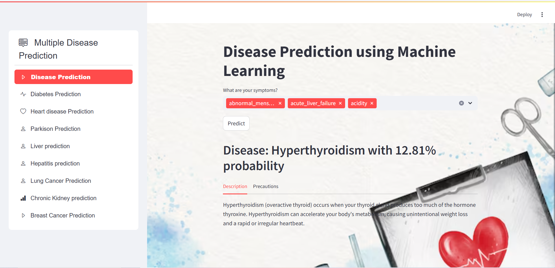
A Look to My Disease Prediction System :-

Slide 10
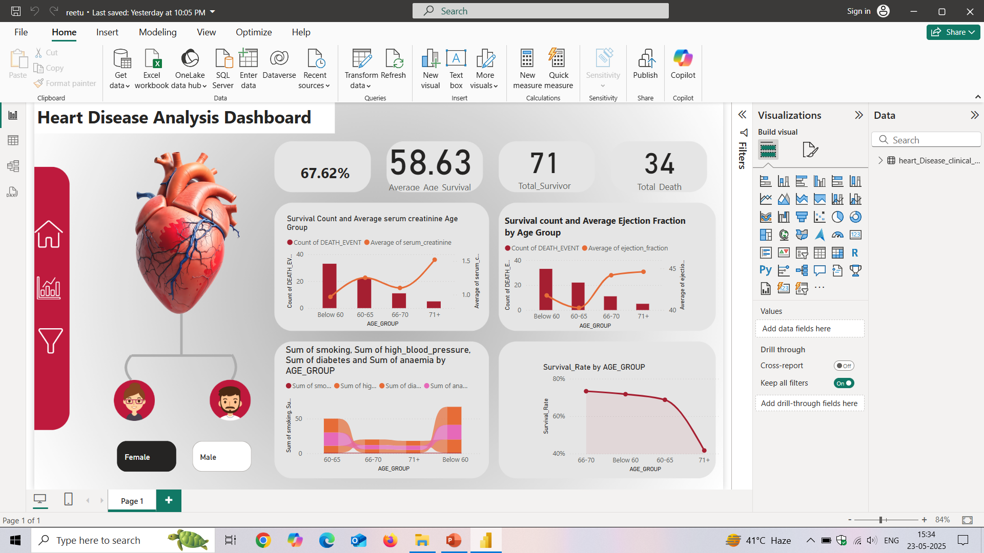
Power BI Dashboard

Slide 11
PROJECT REQUIREMENTS
Software USED : Python interpreter , Jupyter notebook, Vs code ,Power BI
Front-end USED : Streamlit python library, Plotly, Seaborn, Matplotlib
Back –end USED: scikit-learn, pandas, Numpy , XGbBoost

Slide 12
FUTURE SCOPE
In the future we can add more diseases in the existing API.
We can try to improve the accuracy of prediction in order to decrease the mortality rate
Try to make the system user-friendly and provide a chatbot for normal queries

Slide 13
THANK YOU………
- PRESENTED BY-
RITU KUNWAR

